Slide 1
Publicis Sapient Logo

Slide 2


Online banking Transaction System
August 5,2024
Rahul Reddy Siripuram

Slide 3

Agenda
Problem Statement
Implementation
Logic Code
working

Slide 4
Problem Statement
Validate the Forms in Banking system like credit debit and balance amounts using JavaScript Functionalities.

Slide 5
Implementation
.
Created a Responsive layout with a form containing input fields for balance, transaction type, amount and account number.
Implemented a clean ,User-friendly design using CSS
Ensures Credit validation ,Debit validation and balance validation
Prepared the form structure to handle credit , debit, and transfer operations.

Slide 6
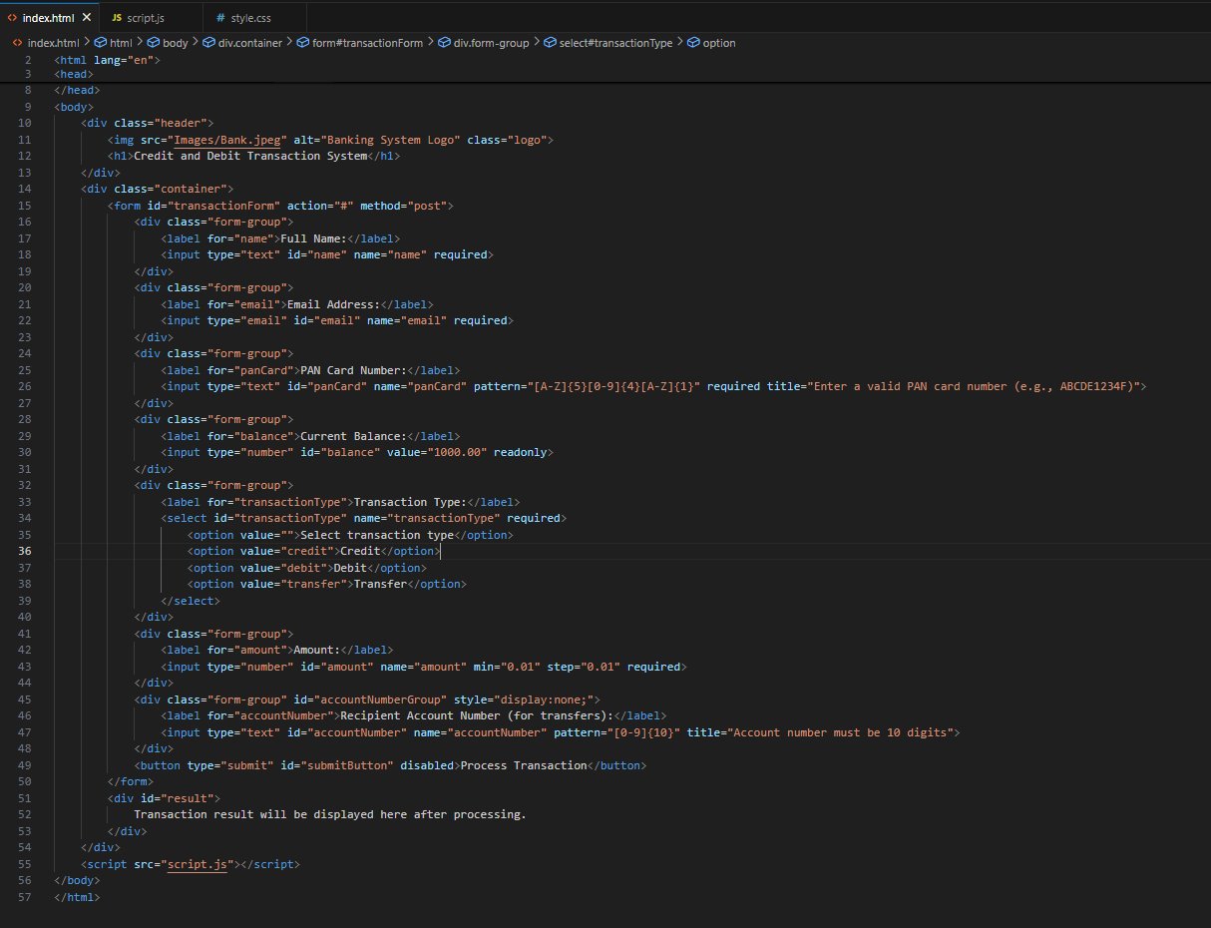
Logic
HTML Part

Slide 7
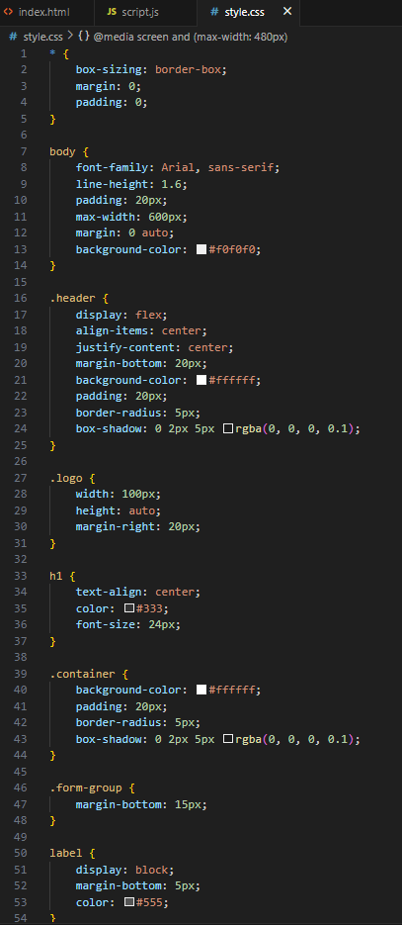
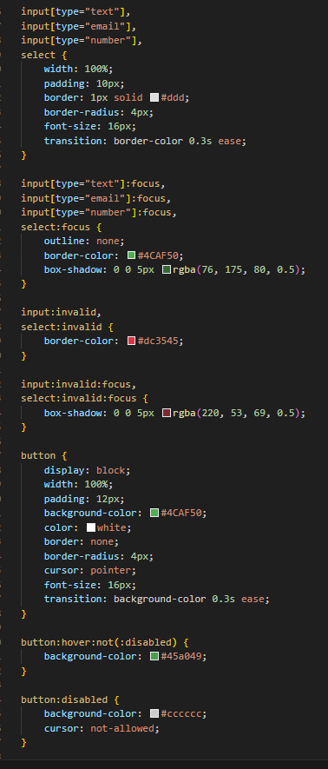
Logic
CSS Part

Slide 8
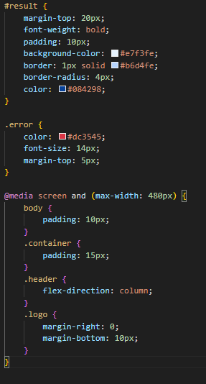
Logic
CSS Part

Slide 9
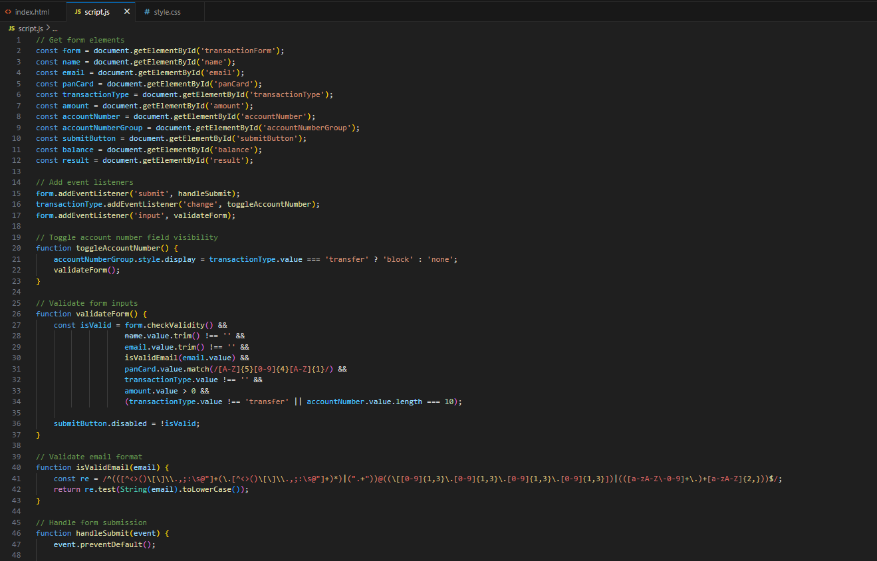
Logic
JS Part

Slide 10
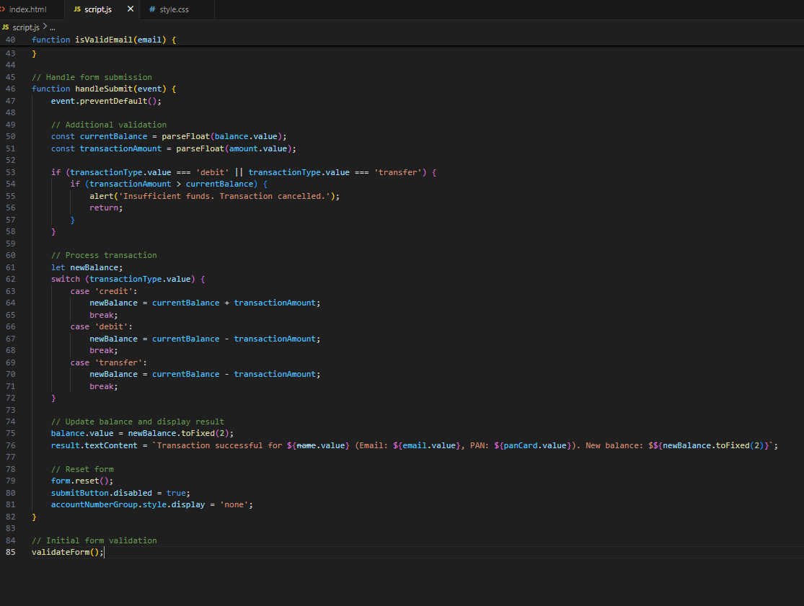
Logic
JS Part

Slide 11
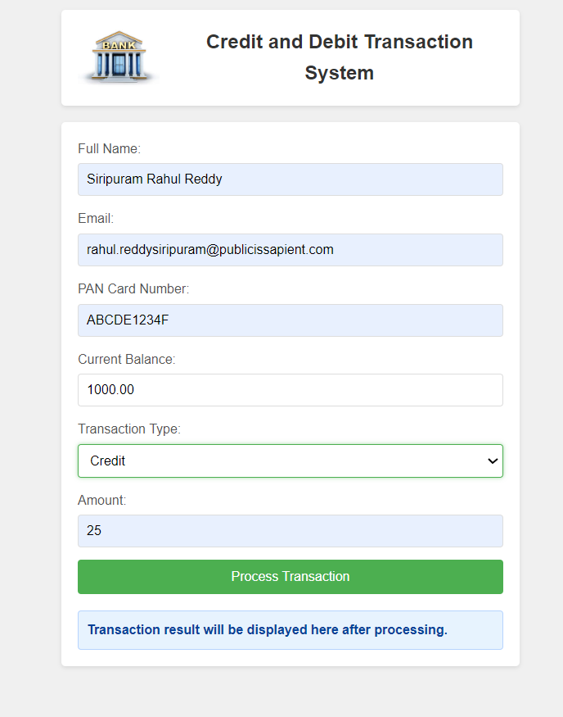
Web Page Design For Credit

Slide 12
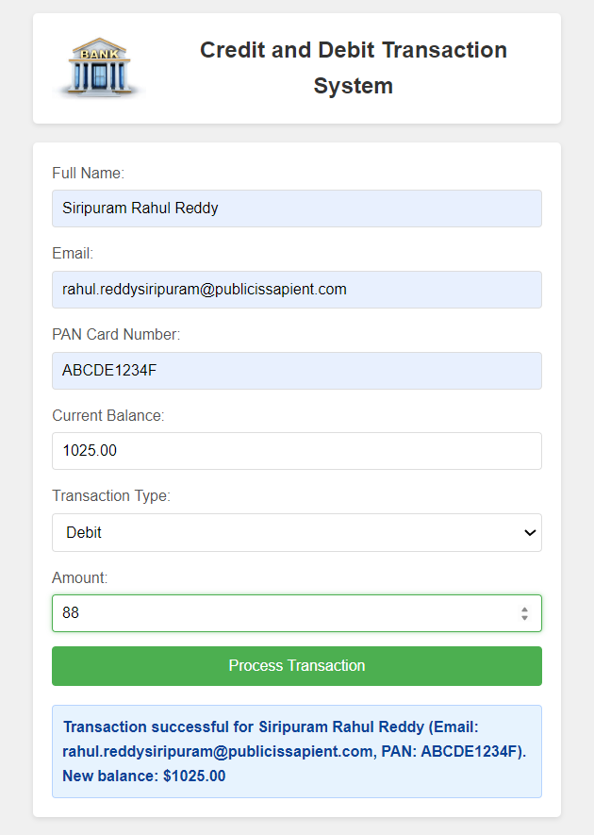
Web Page Design For Debit

Slide 13
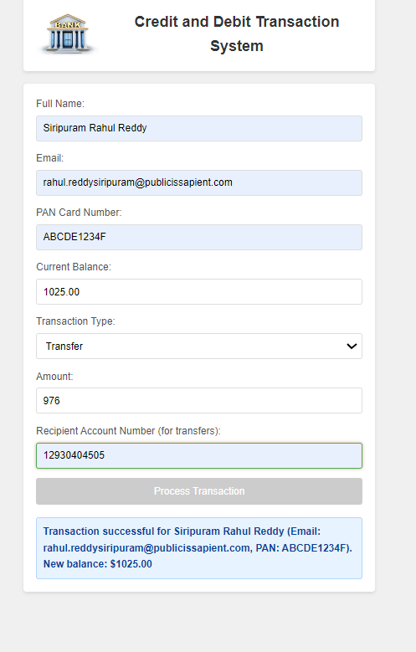
Web Page Design For Transfer

Slide 14
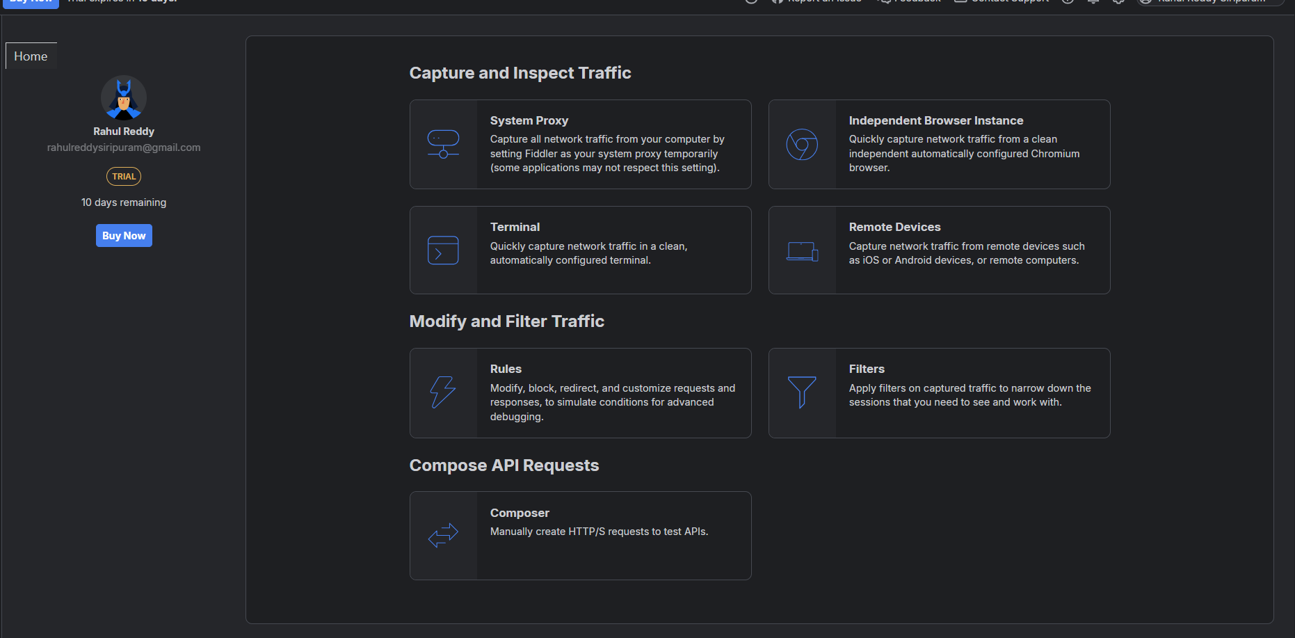
Code Debugging Fiddler

Slide 15
Features of fiddler
.
Traffic Monitoring
Request and Respond Inspection
Performance Testing
Session Replay.

Slide 16
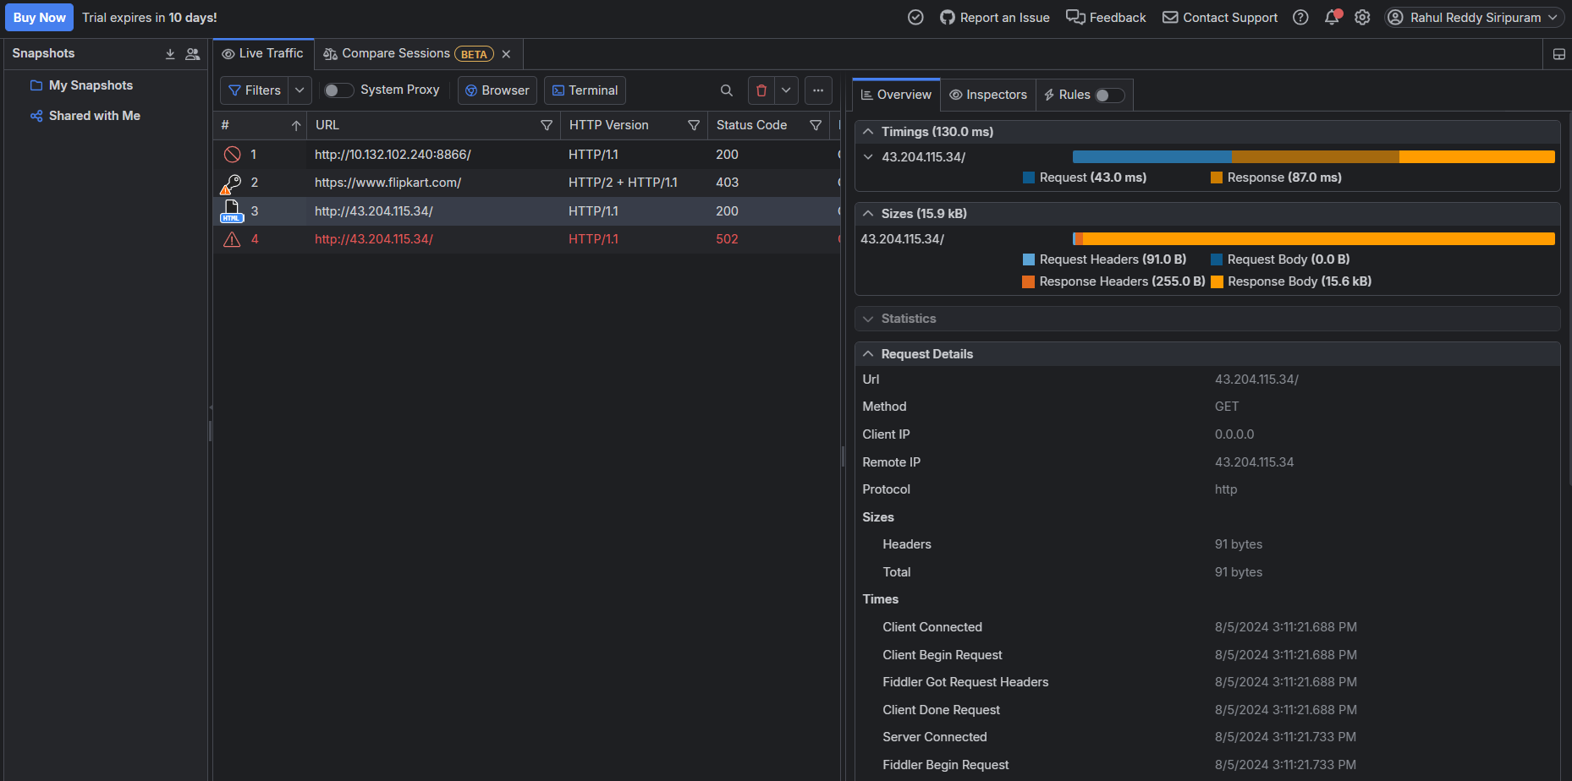
Code Debugging

Slide 17
thank you
rahul.reddysiripuram@publicissapient.com

